Slide 1
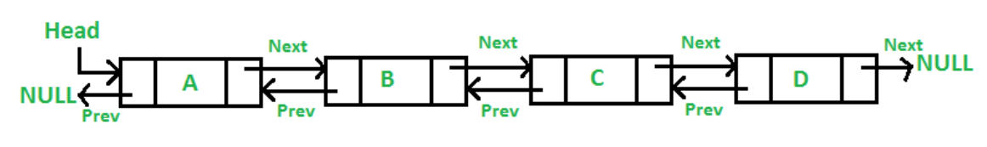
A Doubly Linked List (DLL) contains an extra pointer, typically called previous pointer, together with next pointer and data which are there in singly linked list.

Slide 2
struct Node {
int data;
struct Node* next; // Pointer to next node in DLL
struct Node* prev; // Pointer to previous node in DLL
};

Slide 3
Advantages over singly linked list
1) A DLL can be traversed in both forward and backward direction.
2) The delete operation in DLL is more efficient if pointer to the node to be deleted is given.
3) We can quickly insert a new node before a given node.
In singly linked list, to delete a node, pointer to the previous node is needed. To get this previous node, sometimes the list is traversed. In DLL, we can get the previous node using previous pointer.

Slide 4
Disadvantages over singly linked list
1) Every node of DLL Require extra space for an previous pointer. It is possible to implement DLL with single pointer though (See this and this).
2) All operations require an extra pointer previous to be maintained. For example, in insertion, we need to modify previous pointers together with next pointers. For example in following functions for insertions at different positions, we need 1 or 2 extra steps to set previous pointer.

Slide 5
/* Given a reference (pointer to pointer) to the head of a list
and an int, inserts a new node on the front of the list. */
void push(struct Node** head_ref, int new_data)
{
/* 1. allocate node */
struct Node* new_node = (struct Node*)malloc(sizeof(struct Node));
/* 2. put in the data */
new_node->data = new_data;
/* 3. Make next of new node as head and previous as NULL */
new_node->next = head
new_node->prev = NULL;
/* 4. change prev of head node to new node */
if (head != NULL)
head->prev = new_node;
/* 5. move the head to point to the new node */
head = new_node;
}

Slide 6
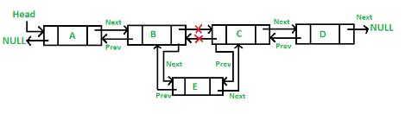

Slide 7
void insertAfter(struct Node* prev_node, int new_data)
{
/*1. check if the given pre v_node is NULL */
if (prev_node == NULL) {
printf("the given previous node cannot be NULL");
return;
}
struct Node* new_node = (struct Node*)malloc(sizeof(struct Node));
/* 3. put in the data */
new_node->data = new_data;
/* 4. Make next of new node as next of prev_node */
new_node->next = prev_node->next;
/* 5. Make the next of prev_node as new_node */
prev_node->next = new_node;
/* 6. Make prev_node as previous of new_node */
new_node->prev = prev_node;
/* 7. Change previous of new_node's next node */
if (new_node->next != NULL)
new_node->next->prev = new_node;
}

Slide 8
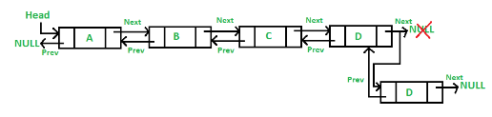

Slide 9
/* Given a reference (pointer to pointer) to the head
of a DLL and an int, appends a new node at the end */
void append(struct Node * head, int new_data)
{
/* 1. allocate node */
struct Node* new_node = (struct Node*)malloc(sizeof(struct Node));
struct Node* last = head_ref; /* used in step 5*/
/* 2. put in the data */
new_node->data = new_data;
/* 3. This new node is going to be the last node, so
make next of it as NULL*/
new_node->next = NULL;
/* 4. If the Linked List is empty, then make the new
node as head */
if (head == NULL) {
new_node->prev = NULL;
head = new_node;
return;
}
/* 5. Else traverse till the last node */
while (last->next != NULL)
last = last->next;
/* 6. Change the next of last node */
last->next = new_node;
/* 7. Make last node as previous of new node */
new_node->prev = last;

Slide 10
Stack using linked list node * rear node *front=rear=null
void push(int data) { if (top == NULL) { top =(struct node *)malloc(1*sizeof(struct node)); top->ptr = NULL; top->info = data; } else { temp =(struct node *)malloc(1*sizeof(struct node)); temp->ptr = top; temp->info = data; top = temp; } count++; }
void insert(int data)
{ if (rear== NULL)
{
rear =(struct node *)malloc(1*sizeof(struct node));
Front=rear;
front->ptr = NULL;
front->info = data;
}
else
{
temp =(struct node *)malloc(1*sizeof(struct node));
rear->ptr = temp;
temp->info = data;
rear= temp; }
}

Slide 11
void display()
{ top1 = top;
if (top1 == NULL)
{
printf("Stack is empty"); return; }
while (top1 != NULL)
{
printf("%d ", top1->info);
top1 = top1->ptr; }
}

Slide 12
void pop()
{
top1 = top;
if (top1 == NULL)
{
printf("\n Error : Trying to pop from empty stack");
return;
}
else top1 = top1->ptr;
printf("\n Popped value : %d", top->info); free(top);
top = top1;
}

Slide 13
int Isempty() {
if (top == NULL)
return 1
Else
Return 0
}
int IsFull() {
Node *p=(node *)malloc(sizeof(node));
if (p == NULL)
return 1
else
{
free(p);
return 0;
}

Slide 14
void destroy()
{
top1 = top;
while (top1 != NULL)
{
  top1 = top->ptr;
  free(top);
  top = top1;
  top1 = top1->ptr;
}
free(top1);
top = NULL;
printf("\n All stack elements destroyed");
}

